Slide 1

Data-Driven Insights for Music Personalization
Alexandra Segkou
Dimitris Mysiloglou
Kyriakos Papadopoulos

Slide 2
Overview:
This analysis focuses on the top 2000 songs on Spotify, spanning from 1956 to 2019.
The dataset contains audio features such as Danceability, BPM, Liveness, Valence (Positivity), and more.
Objective:
To explore and understand the key characteristics of these top tracks.
To cluster songs based on their audio features in order to identify distinct groups.
Understanding our music data helps us make informed decisions for marketing, playlist curation, and audience engagement.
Our goal is to identify patterns and group similar songs together to better understand our music collection.
Dataset Source:
The data was extracted from Spotify by @plamere and downloaded by us through kaggle.com

Slide 3
Exploratory Data Analysis
We cleaned and standardized the data to ensure accuracy and reliability.

Slide 4
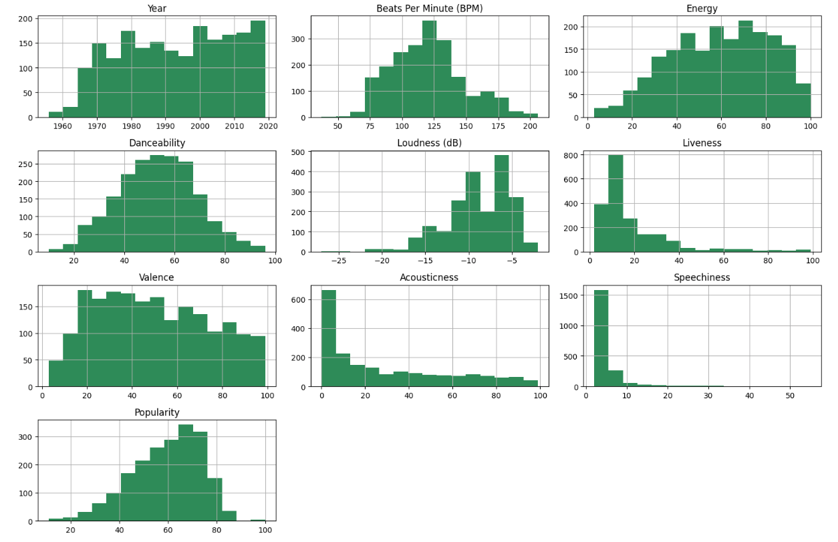
Understanding the Data
The data show a diverse range of audio features, reflecting the variety in the top 2000 songs.
The increasing number of songs over time highlights Spotify’s growing catalogue.
Popular songs span a broad range of BPM, energy, danceability and other features, indicating that there no single pattern to a hit.

Slide 5
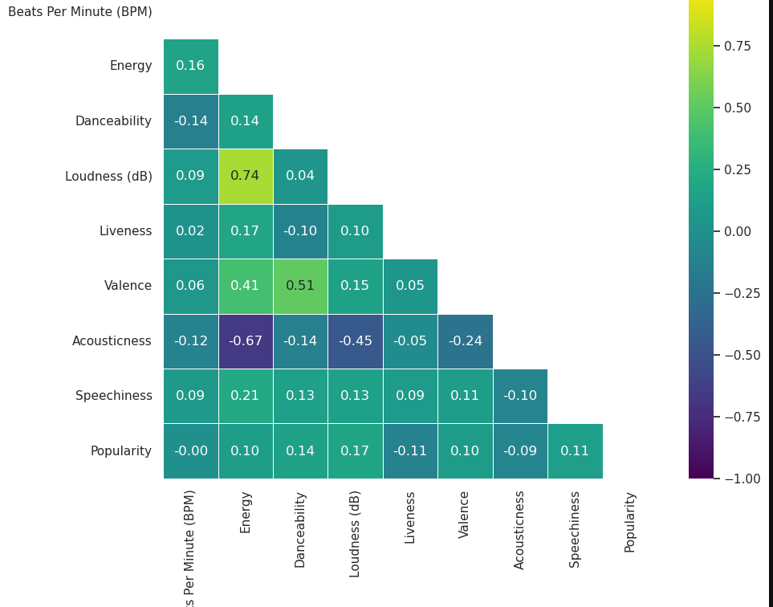
Correlation Analysis
High Correlations:
Energy and Loudness (0.74): Energetic songs tend to be louder.
Danceability and Valence (0.51): Happier songs are more danceable.
Low or Negative Correlations:
Accousticness and Energy (-0.67): Acoustic songs are less energetic.
Popularity:
There doesn’t seem to be a single feature that strongly correlates with popularity.

Slide 6
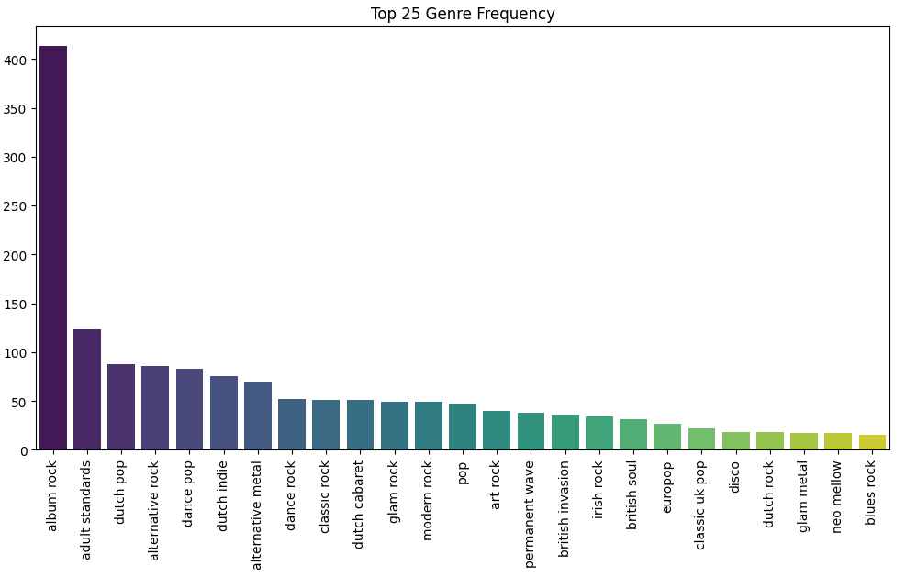
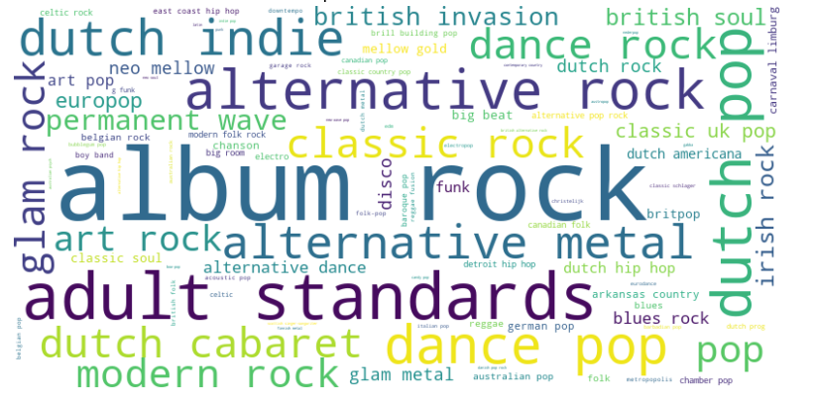
Genre Analysis
Keys Observations:
“Album Rock” is by far the most popular genre.
Notably, 4 out of the top 25 genres are Dutch, highlighting the influence of Dutch music in the dataset.

Slide 7
Understanding our method to group songs
We used an unsupervised algorithm, which means that we didn't give the computer specific instructions on what to look for in the data.
The elbow method helps us determine the optimal number of groups (or clusters) to divide our data into.
K-means clustering helps us categorize our songs into different clusters with similar features, making it easier to understand and analyze the patterns in our music collection.

Slide 8
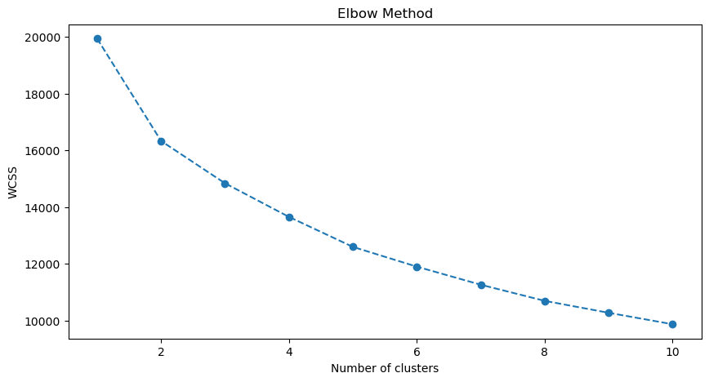
Determining Optimal Number of Clusters
To determine the optimal number of clusters to use for K-Means clustering we decided to use the Elbow Method.
This method helps identify the point where adding more clusters does not significantly reduce the within-cluster sum of squares (WCSS)

Slide 9
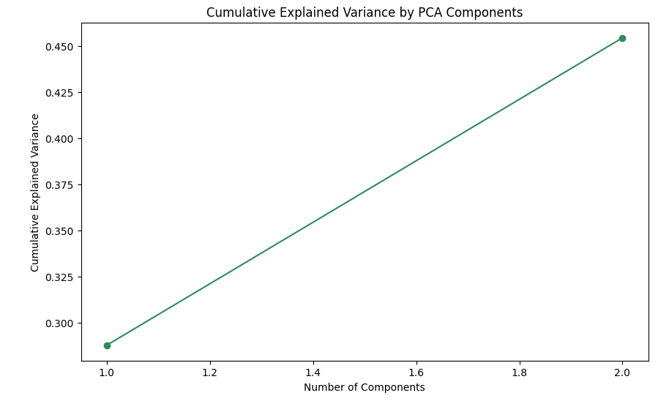
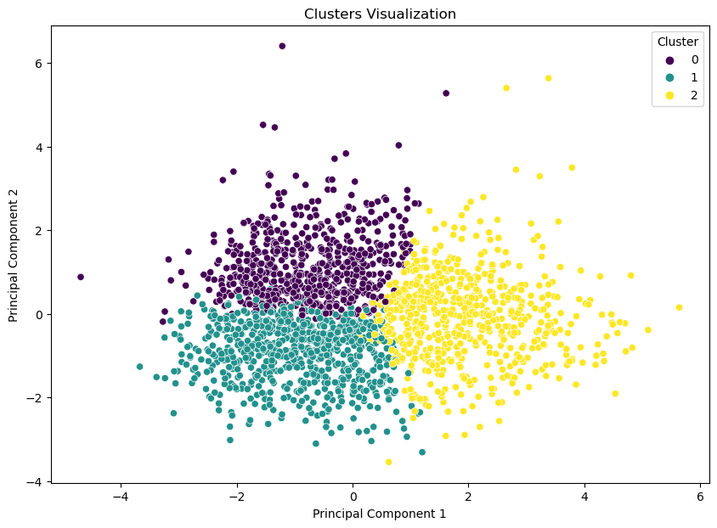
PCA for Dimensionality Reduction
The plot shows that the first two principal components capture a meaningful portion of the variance in the dataset, justifying their use for dimensionality reduction.
The scatter plot effectively demonstrates the clustering of songs in the reduced PCA space.
The distinct separation between clusters suggests that PCA has successfully captured the underlying structure of the data.

Slide 10
What We Found
We identified 3 main groups (or clusters) of songs, each with unique characteristics.

Slide 11
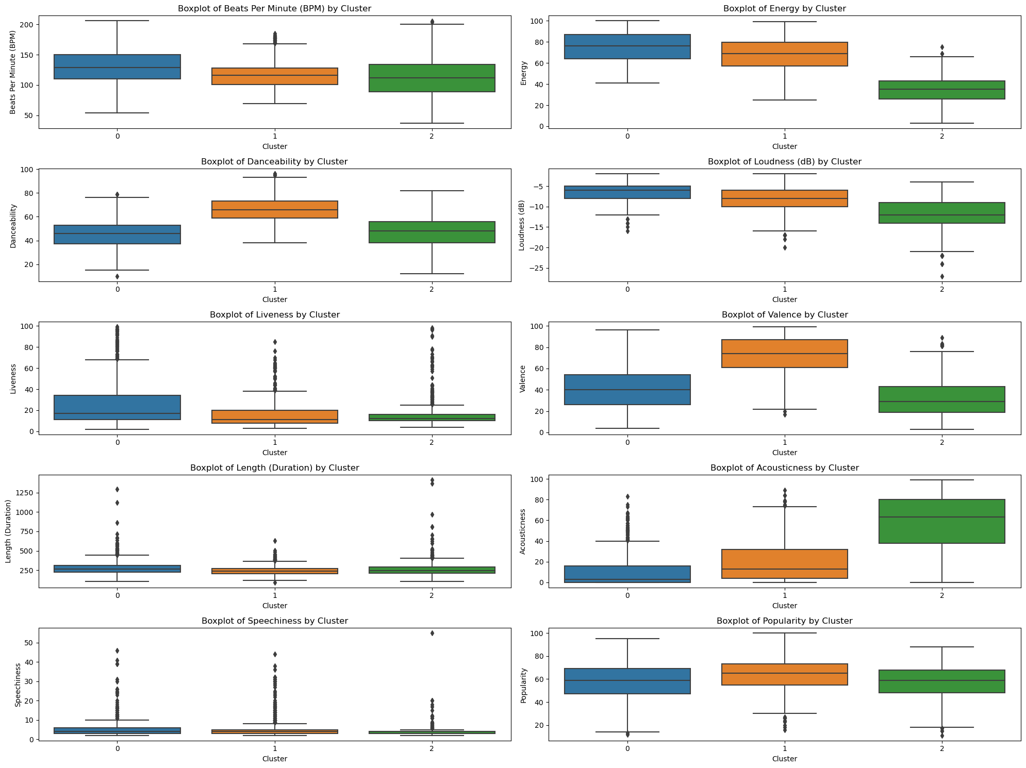
Cluster Characteristics
Cluster 0: More Beat Per Minute (BPM), energy, loudness, and liveness, with least acousticness.
Cluster 1: Highest valence among the clusters, indicating more positive, happy-sounding tracks. High danceability.
Cluster 2: More acousticness, quieter with less valence and energy, and less liveness.

Slide 12
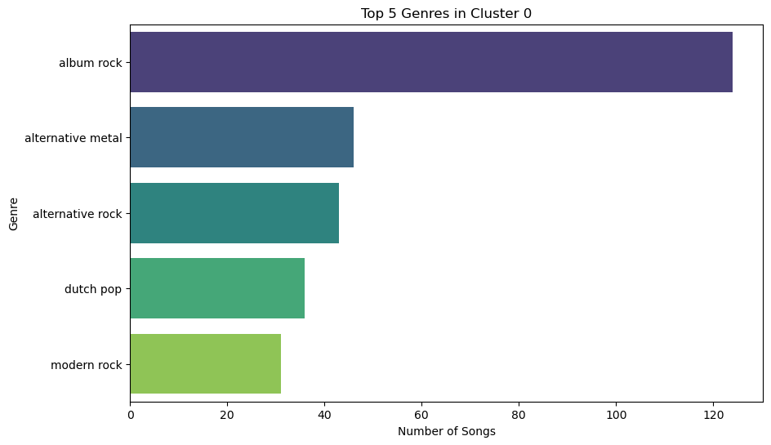
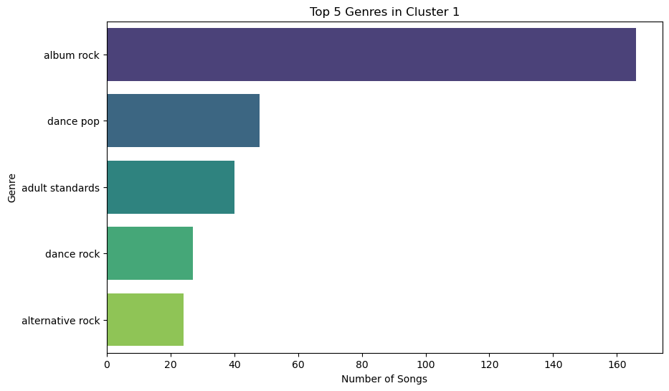
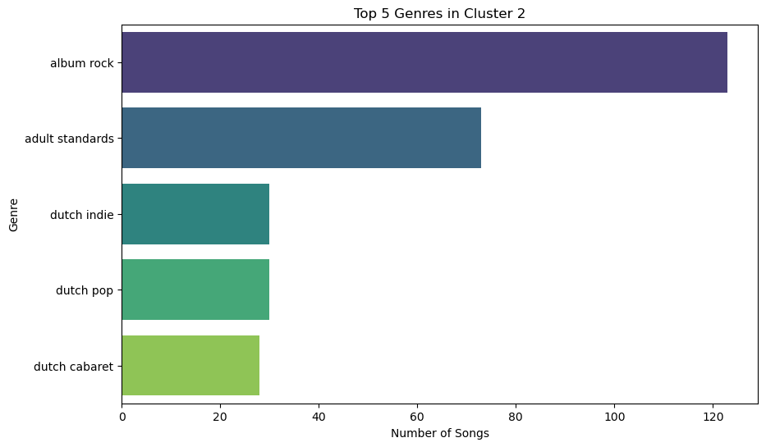
Cluster 0: More Beat Per Minute (BPM), energy, loudness, and liveness, with least acousticness. Top 5 Genres: album rock, alternative metal, alternative rock, dutch pop, modern rock.
Cluster 1: Highest valence among the clusters, indicating more positive, happy-sounding tracks. High danceability. Top 5 Genres: album rock, dance pop, adult standards, dance rock, alternative rock.
Cluster 2: More acousticness, quieter with less valence and energy, and less liveness. Top 5 genres: album rock, adult standards, dutch indie, dutch pop, dutch cabaret.

Slide 13
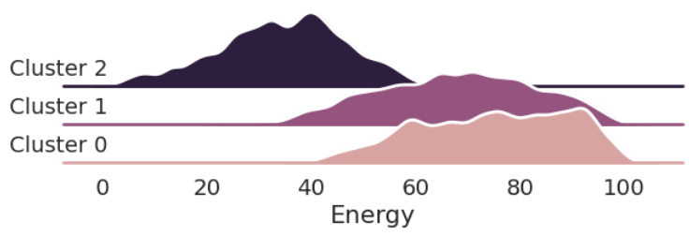
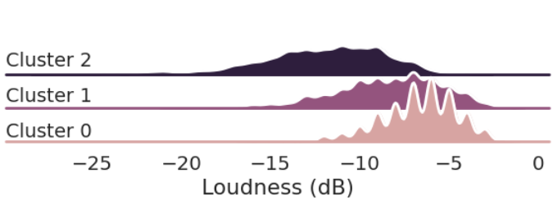
Top Identifiers (Cluster 0)

Slide 14
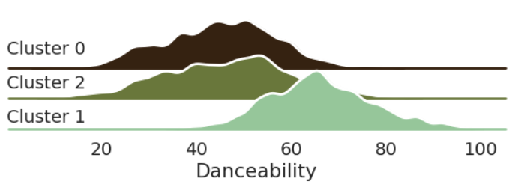
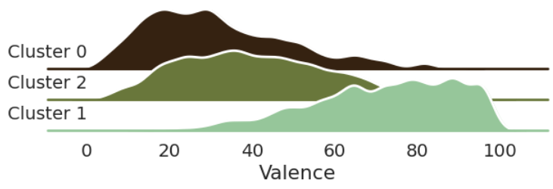
Top Identifiers (Cluster 1)

Slide 15
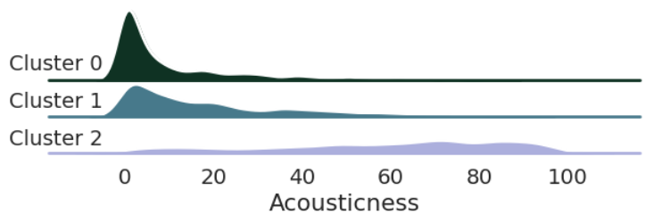
Top Identifiers (Cluster 2)

Slide 16
Conclusion
We found distinct groups of songs with unique characteristics. This can help us in making better decisions for creating playlists and marketing campaigns.
Next steps:
- Use this analysis to create targeted playlists.
- Develop marketing strategies based on song characteristics.

Slide 17
Thank you for your time.
Feel free to reach out with any questions.

